Slide 1

Presentation on Account Manager Project

Slide 2
AGENDA
Problem Statement
Overview of the Project
Our Solution
Wow Factor
Modeling
Conclusion
Meet Our Team

Slide 3

Problem Statement
Challenge: Efficiently managing and keeping track of various user accounts
Issues Faced
Manual management prone to errors
Security concerns with passwords
Tedious to retrieve account details

Slide 4

Overview of the Project
Objective: Develop an Account Manager using Python and MySQL
User-friendly GUI for account creation and updates
Secure password handling
Automatic account number generation
Real-time display of account details

Slide 5

Our Solution
Python for backend logic
MySQL database for persistent storage
Tkinter for GUI
Functionality
Create new accounts with unique account numbers
Update existing accounts with new amounts
Real-time display of account details

Slide 6

Wow Factor
Automatic Account Number Generation
Unique 16-digit account numbers generated on the fly
Secure Password Handling
Passwords masked in GUI for enhanced security
Real-time Account Details Display
Instantly view account details in the application

Slide 7
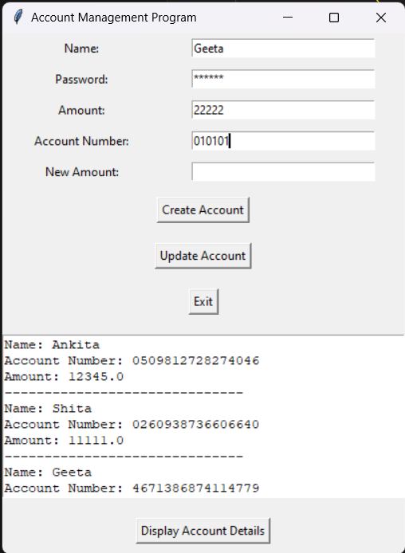
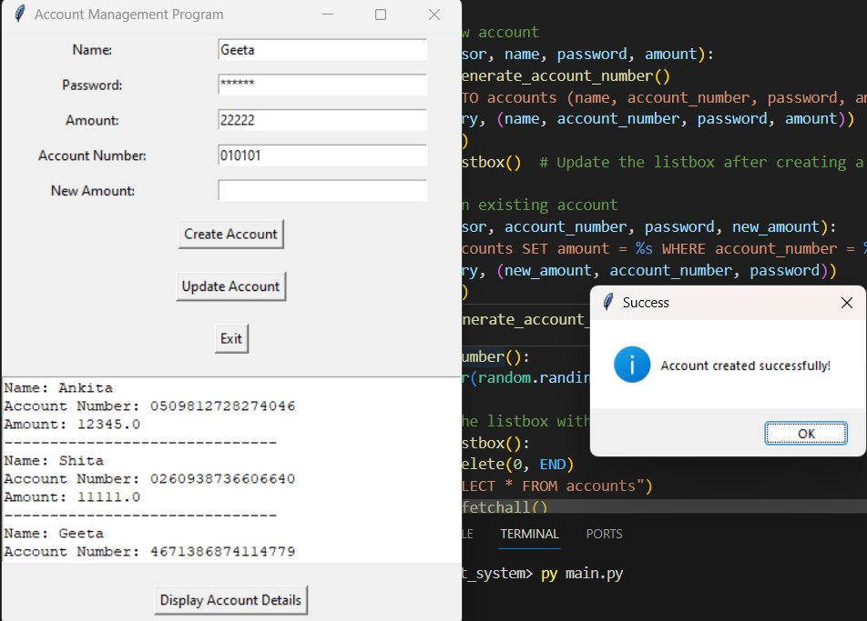
Result

Slide 8
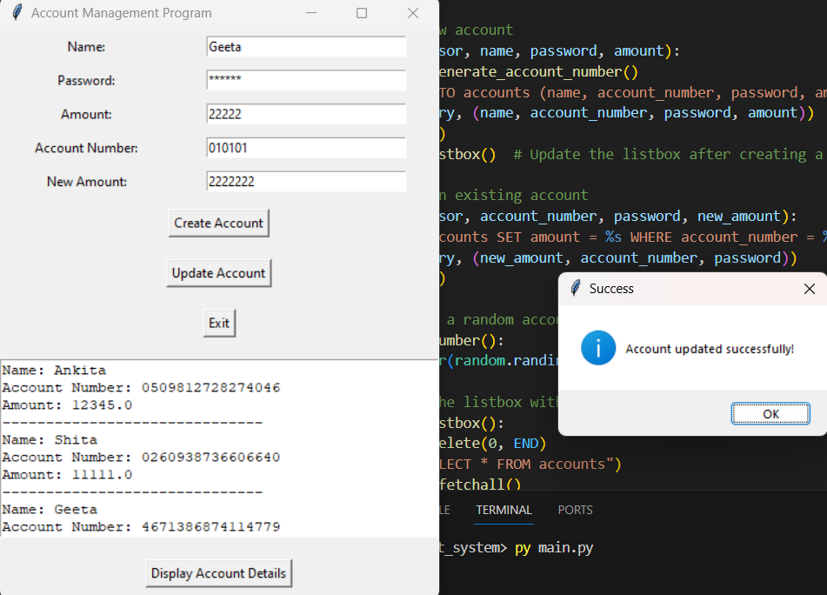
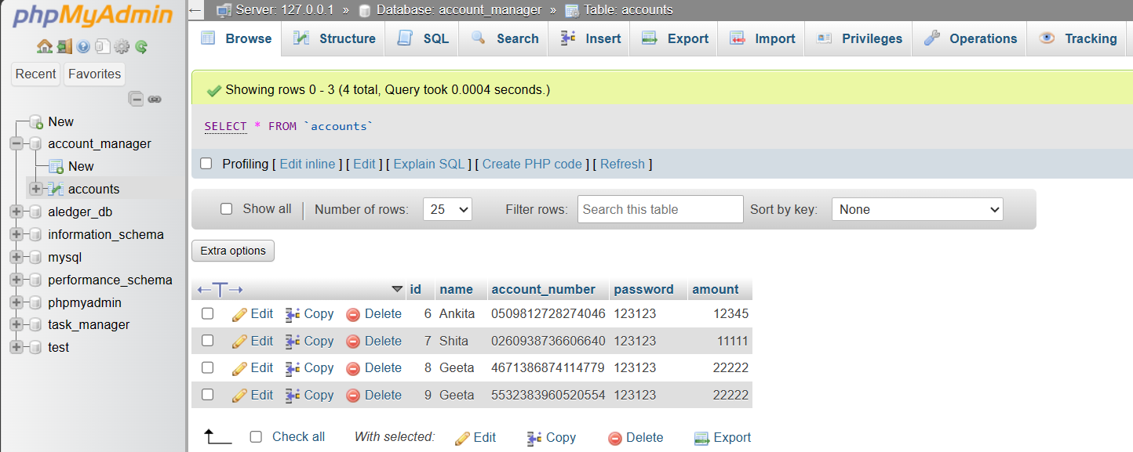
Result

Slide 9
Modeling
Database Structure
'accounts' table with columns: id, name, account_number, password, amount
Auto-incremented primary key for each account
GUI Elements
Entry widgets for user input
Listbox for displaying account information
Buttons for account management actions

Slide 10
Conclusion
Achievements
Efficient account management
Enhanced security with password masking
Real-time updates and display
Future Enhancements
Encryption for password storage
Multi-user support

Slide 11

Meet Our Team

Slide 12

Thank you for your attention!

